Slide 1
Chapter 7
How to work with form data

Slide 2
Applied objectives
Use text boxes, password boxes, radio buttons, check boxes, drop-down lists, list boxes, and text areas to get input from the user.
Use hidden fields to pass data to the web application when a form is submitted.
Use the htmlspecialchars and nl2br functions to display user entries the way you want them displayed.
Use echo statements to display data in a web page.

Slide 3
Knowledge objectives
Describe the way a PHP application gets data from text boxes, password boxes, hidden fields, radio buttons, check boxes, drop-down lists, list boxes, and text areas.
Describe the use of the htmlspecialchars and nl2br functions.
Describe the use of the echo and print statements.

Slide 4
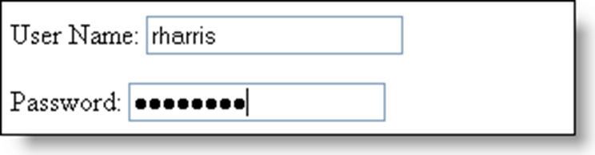
Text input: the HTML for three types of fields
<input type="text" name="user_name" value="rharris">
<input type="password" name="password">
<input type="hidden" name="action" value="login">
The text and password fields in the browser

Slide 5
The URL using the GET method for the form with a password
process_data.php?user_name=rharris&password=s3cr3t72&action=login
The PHP for the GET method
<?php
$user_name = filter_input(INPUT_GET, 'user_name');
$password = filter_input(INPUT_GET, 'password');
$action = filter_input(INPUT_GET, 'action');
?>
The URL using the POST method for the form
process_data.php
The PHP for the POST method
<?php
$user_name = filter_input(INPUT_POST, 'user_name');
$password = filter_input(INPUT_POST, 'password');
$action = filter_input(INPUT_POST, 'action');
?>

Slide 6
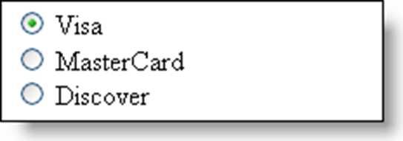
The HTML for three radio buttons in a group
<input type="radio" name="card_type" value="visa" checked> Visa<br>
<input type="radio" name="card_type" value="mastercard"> MasterCard<br>
<input type="radio" name="card_type" value="discover"> Discover
The radio buttons in the browser

Slide 7
PHP to access a radio button group
<?php
$card_type = filter_input(INPUT_POST, 'card_type');
?>
PHP to add a default value for a group with no default button
<?php
$card_type = filter_input(INPUT_POST, 'card_type');
if ($card_type == NULL) {
$card_type = 'unknown';
}
?>

Slide 8
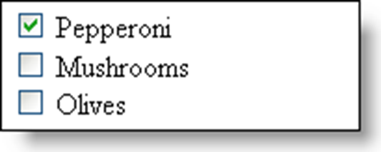
The HTML for three check boxes
<input type="checkbox" name="pep" checked> Pepperoni<br>
<input type="checkbox" name="msh"> Mushrooms<br>
<input type="checkbox" name="olv"> Olives
The check boxes in the browser
The PHP to access the check box data
<?php
$pepperoni = isset($_POST['pep']);
$mushrooms = isset($_POST['msh']);
$olives = isset($_POST['olv']);
?>

Slide 9
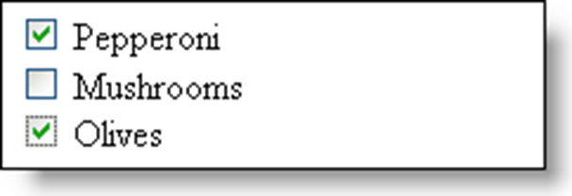
Three related check boxes in an array
<input type="checkbox" name="top[]" value="pep"> Pepperoni<br>
<input type="checkbox" name="top[]" value="msh"> Mushrooms<br>
<input type="checkbox" name="top[]" value="olv"> Olives
The check boxes in the browser

Slide 10
PHP that accesses the array and its values
<?php
$toppings = filter_input(INPUT_POST, 'top',
FILTER_SANITIZE_SPECIAL_CHARS, FILTER_REQUIRE_ARRAY);
if ($toppings !== NULL) {
$top1 = $toppings[0]; // $top1 is pep
$top2 = $toppings[1]; // $top2 is olv
$top3 = $toppings[2]; // $top3 is not set – error
}
?>

Slide 11
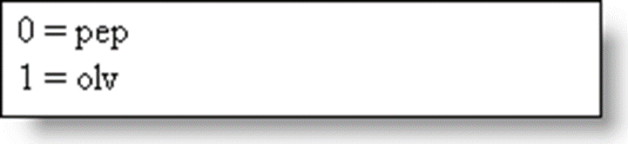
PHP that uses a loop to process the array
<?php
$toppings = filter_input(INPUT_POST, 'top',
FILTER_SANITIZE_SPECIAL_CHARS, FILTER_REQUIRE_ARRAY);
if ($toppings !== NULL) {
foreach($toppings as $key => $value) {
echo $key. ' = ' . $value . '<br>';
}
} else {
echo 'No toppings selected.';
}
?>
The message displayed by the browser

Slide 12
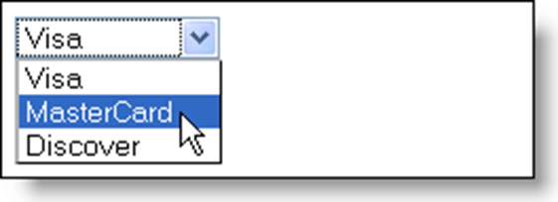
The HTML for a drop-down list
<select name="card_type">
<option value="visa">Visa</option>
<option value="mastercard">MasterCard</option>
<option value="discover">Discover</option>
</select>
The drop-down list in a browser
The HTML to set a default option
<option value="mastercard" selected>MasterCard</option>
The PHP to access the drop-down list data
<?php
$card_type = filter_input(INPUT_POST, 'card_type');
?>

Slide 13
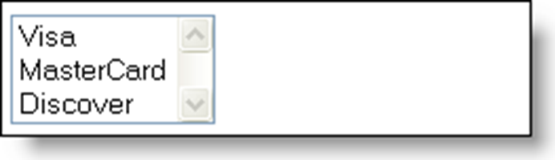
A list box that doesn’t allow multiple selections
<select name="card_type" size="3">
<option value="visa">Visa</option>
<option value="mastercard">MasterCard</option>
<option value="discover">Discover</option>
</select>
The list box in a browser

Slide 14
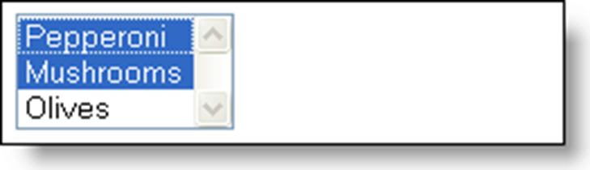
A list box that allows multiple selections
<select name="top[]" size="3" multiple>
<option value="pep" selected>Pepperoni</option>
<option value="msh">Mushrooms</option>
<option value="olv">Olives</option>
</select>
The list box in a browser

Slide 15
PHP for a list box that allows multiple selections
<?php
$toppings = filter_input(INPUT_POST, 'top',
FILTER_SANITIZE_SPECIAL_CHARS, FILTER_REQUIRE_ARRAY);
if ($toppings !== NULL) {
foreach ($toppings as $key => $value) {
echo $key. ' = ' . $value . '<br>'; // 0 = pep, 1 = msh
}
} else {
echo 'No toppings selected.';
}
?>

Slide 16
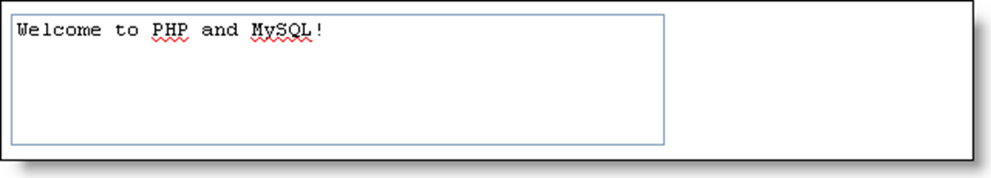
The HTML for a text area
<textarea name="comment" rows="4" cols="50">Welcome
to PHP and MySQL!</textarea>
A text area in the browser

Slide 17
The URL when using the GET method
When the user includes spaces in the text area
process_data.php?comment=Welcome+to+PHP+and+MySQL!
When the user presses the Enter or Return key
process_data.php?comment=Welcome+to%0D%0APHP+and+MySQL!
When the user doesn’t enter any text
process_data.php?comment=
The PHP to get the data from the text area
<?php
$comment = filter_input(INPUT_POST, 'comment');
?>

Slide 18
Syntax of the htmlspecialchars() function
htmlspecialchars($string[, $quote_style[, $charset[,
$double_encode]]])
Common HTML character entities
Character Character entity
& &amp;
< &lt;
> &gt;
" &quot;
' &#039;
Non-breaking space &nbsp;

Slide 19
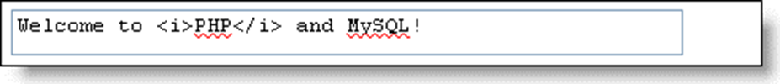

An example that uses special characters
The text entered by the user
PHP that converts special characters to character entities
<?php
$comment = $_POST['comment'];
$comment = htmlspecialchars($comment);
?>
<p><?php echo $comment; ?></p>
The data displayed in the browser

Slide 20
A double-encoded less than character entity (&lt;)
&amp;lt;
A statement that prevents double encoding
$comment = htmlspecialchars($comment, ENT_COMPAT,
'ISO-8859-1', false);

Slide 21
Syntax of the nl2br() function
nl2br($string[, $is_xhtml])

Slide 22
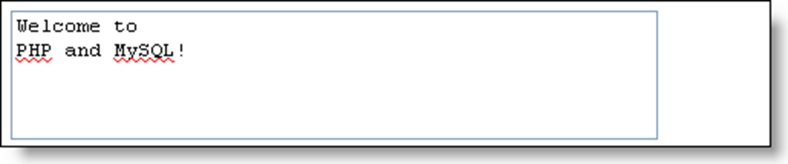

The text entered into the text area
Converting line break characters to line break tags
<?php
$comment = filter_input(INPUT_POST, 'comment');
$comment = nl2br($comment, false);
// use <br> tags, not <br /> tags
?>
<p><?php echo $comment; ?></p>
The data displayed in the browser

Slide 23
The echo statement
Syntax
echo $var1
echo($var1)
echo $var1 [, $var2 ...]
Examples
echo 'Welcome to PHP and MySQL!';
echo 'Name: ' . $name;
echo('Name: ' . $name);
echo 'Cost: $', $cost;

Slide 24
The print statement
Syntax
echo $var1
echo($var1)
echo $var1 [, $var2 ...]
Examples
print 'Welcome to PHP and MySQL!';
print 'Name: ' . $name;
print('Name: ' . $name);
Using print in an expression
<?php
($age >= 18) ? print('Can vote.') : print('Cannot vote.');
?>

